Slide 1
Advanced Front-End Programming (CPAN 144)
Week 2
Lecturer: Harshdeep Singh
Winter 2023

Slide 2
Agenda
Introduction to JSON
Fetching JSON/XML using:
Fetch API

Slide 3
What is JSON?
JSON is short for JavaScript Object Notation.
It was originally created by Douglas Crockford in 2001 for a company called State Software.
Official website: https://www.json.org/
JSON is a syntax for storing and exchanging data.
JSON is text, written with JavaScript object notation.
however it's truly platform and language independent.

Slide 4
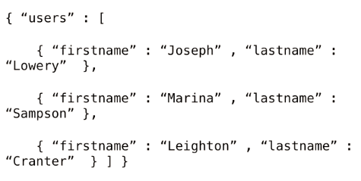
Sample JSON
As you could tell from the code, data is expressed in simple name/value pairs.
Multiple name/value pairs can be separated by commas and enclosed by curly braces.
Square brackets define arrays

Slide 5
JSON Syntax Rules
Data is in name/value pairs
Data is separated by commas
Curly braces hold objects
Square brackets hold arrays
The file type for JSON files is ".json"
The MIME type for JSON text is "application/json"
In JSON, values must be one of the following data types:
a string
In JSON, string values must be written with double quotes
a number
an object (JSON object)
an array
a Boolean
null

Slide 6
JSON Tools
JSON Editor online
https://jsoneditoronline.org/

Slide 7
Activity 1
Design a JSON file for representing the following information:
Save the file as Actvitiy1_yourname.JSON
Plateno | Make | Model | Price
ABX123 | Toyota | Corolla | 23000
NMP432 | Mazda | III | 32000
PAK988 | Honda | Civic | 19500

Slide 8
JSON Tools
JSON Validator
https://jsonlint.com/

Slide 9
Process JSON using JavaScript
Because JSON syntax is derived from JavaScript object notation, very little extra software is needed to work with JSON within JavaScript.
With JavaScript you can create an object and assign data to it, like this:
var person = { "name":"John", "age":31, "city":"New York" };
You can access a JavaScript object like this:
person.name;
person["name"];
// returns John

Slide 10
How to parse JSON data in JavaScript
Use the JavaScript to process JSON data:
Example:
var obj= { name:"John", age:30, city:"New York"};
Console.log(obj);
document.write(obj.name + ", " + obj.age);

Slide 11
Activity 2
Based on the designed JSON data, develop a JS program which displays all of the data.
Hardcode the JSON data into the JS program
Save the file as Actvitiy2_yourname.HTML
Plateno | Make | Model | Price
ABX123 | Toyota | Corolla | 23000
NMP432 | Mazda | III | 32000
PAK988 | Honda | Civic | 19500

Slide 12
Why JSON?
When exchanging data between a browser and a server, the data can only be text.
JSON is text, and we can convert any JavaScript object into JSON, and send JSON to the server.
We can also convert any JSON received from the server into JavaScript objects.

Slide 13
Fetching data from the server
To manage interaction between frontEnd and backend, JavaScript provides two famous way to send HTTP request and receive HTTP response using:
XHR
Fetch API
These two techniques extract data from the backend service mainly in JSON format and bring them to the frontEnd

Slide 14
Processing JSON using AJAX

Slide 15
What is AJAX
AJAX = Asynchronous JavaScript and XML.
AJAX is a technique for creating fast and dynamic web pages.
AJAX allows web pages to be updated asynchronously by exchanging small amounts of data with the server behind the scenes. This means that it is possible to update parts of a web page, without reloading the whole page.
Classic web pages, (which do not use AJAX) must reload the entire page if the content should change.

Slide 16
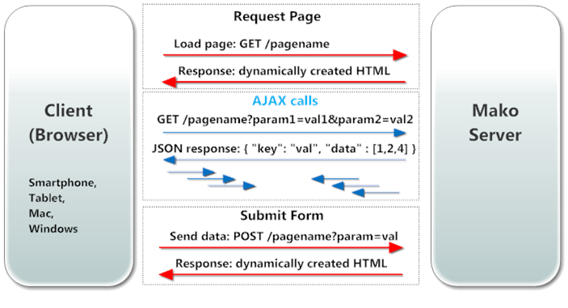
Exchanging Data
Server

Slide 17

Fetch API

Slide 18
Fetch API
The Fetch API provides a JavaScript interface for accessing and manipulating parts of the HTTP pipeline, such as requests and responses.
The Fetch API, has been standardized as a modern approach to asynchronous network requests, and uses Promises as a building block.

Slide 19
What is a Promise?
The Promise object represents the eventual completion (or failure) of an asynchronous operation and its resulting value.
This lets asynchronous methods return values like synchronous methods: instead of immediately returning the final value, the asynchronous method returns a promise to supply the value at some point in the future.

Slide 20
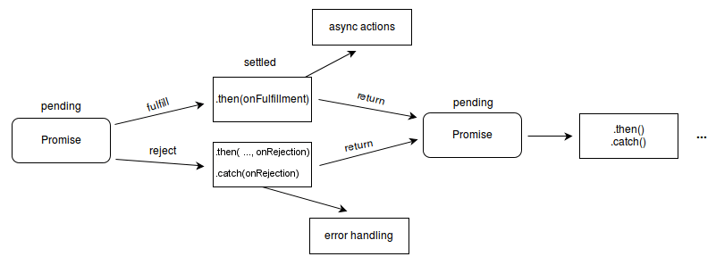
How Promise works
A Promise is in one of these states:
pending: initial state, neither fulfilled nor rejected.
fulfilled: meaning that the operation was completed successfully.
rejected: meaning that the operation failed.

Slide 21
Using Fetch
Starting to use Fetch for GET requests is very simple:
fetch('/file.json')
Calling fetch() returns a promise. We can then wait for the promise to resolve by passing a handler with the then() method of the promise.
fetch('./file.json')
then(function(res){ console.log(res); return(res.json()); })
then(function(data){ console.log(data); })

Slide 22
Fetch using arrow function
fetch('./file.json')
.then(response => response.json())
.then(data => console.log(data))

Slide 23
Catching errors
Since fetch() returns a promise, we can use the catch method of the promise to intercept any error occurring during the execution of the request, and the processing done in the then callbacks:
fetch('./file.json')
.then(response => {
//...
})
.catch(err => console.error(err))

Slide 24
Lab 2
Navigate to Course Content -> Assessments -> Labs -> Lab 2 and download the instruction for lab 1.
Once you fulfill all the requirements of the lab ZIP all your source files and submit them into Course Content -> Assessments -> Labs -> Lab 2
Pay attention to the due date defined on the blackboard submission box for this activity.

